Slide 1
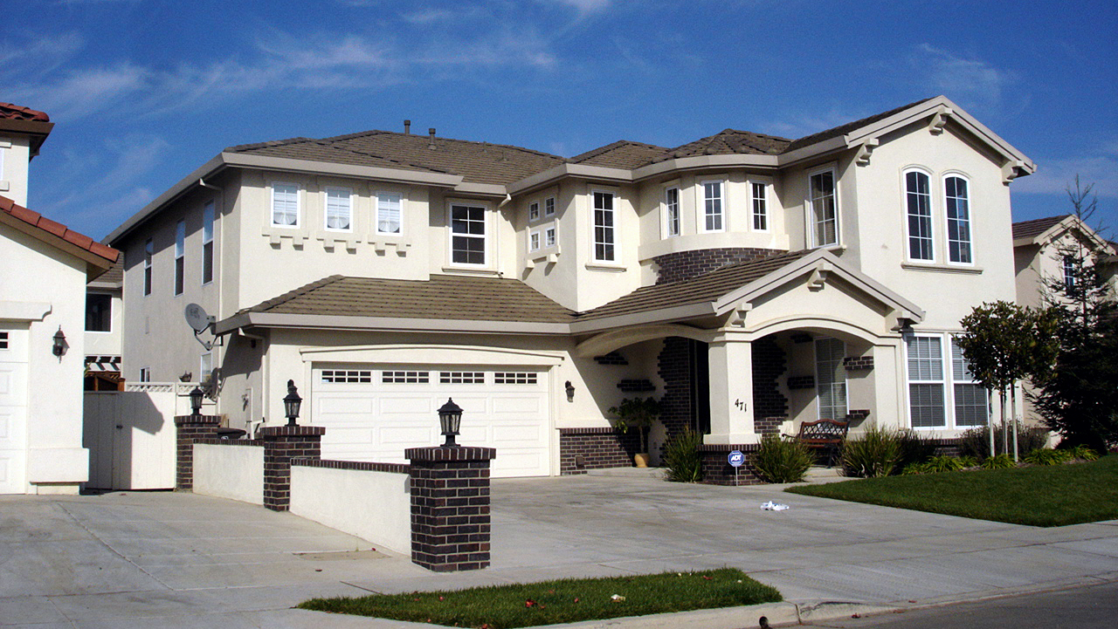
Regression Analysis of Housing Prices
Victor Chen
Luis Osorio
Richard DiazDeLeon
This Photo by Unknown author is licensed under CC BY-SA.

Slide 2
Content
Motivation and Data Set Background
Questions of Interest
Application of Regression Methods
Analysis and Results
L.I.N.E. Conditions

Slide 3

Motivation
Housing prices in the USA have increased over time and we want to see what kind of variables are most important when looking at purchasing a house as an investment
The surrounding neighborhood and city can affect house prices and the data set contains many of those features
The regression model has value when submitting a bid on a house for future homeowners
Bay Area Housing Market .

Slide 4

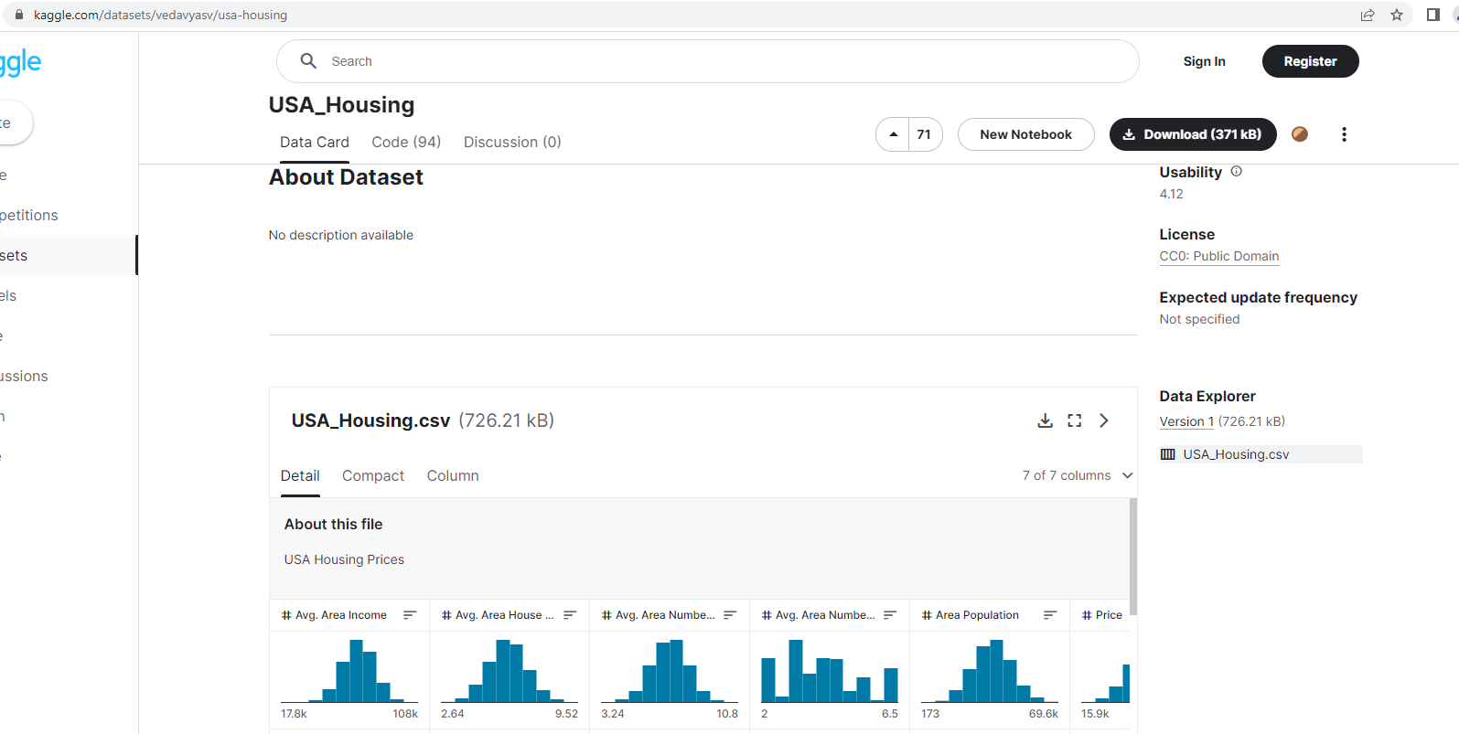
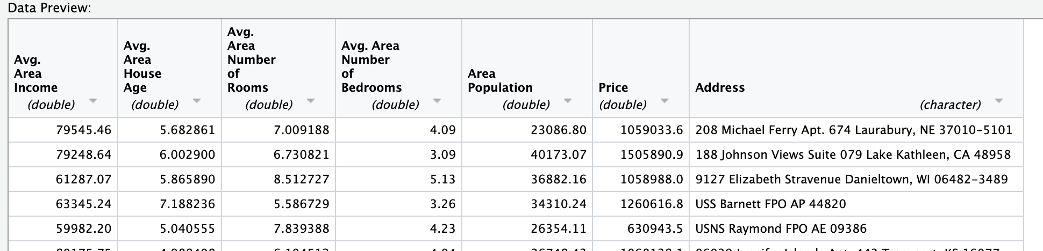
Data Set
5000 rows – house sales from all around the USA
‘Avg. Area Income': Average Income of residents of the city house is located in.
‘Avg. Area House Age': Average Age of Houses in same city
‘Avg. Area Number of Rooms': Average Number of Rooms for Houses in same city
‘Avg. Area Number of Bedrooms': Average Number of Bedrooms for Houses in same city
‘Area Population': Population of city house is located
‘Price: Price that the house sold at
'Address': Address for the house – only categorical column ( was dropped) ***
This dataset was download from Kaggle: https://www.kaggle.com/datasets/vedavyasv/usa-housing

Slide 5
Question Of Interest
Q1: What combination of features (income, age of houses, number of rooms, and number of bedrooms) are statistically significant in predicting the selling price of a house? (t-test on slope parameters)
Q2: Is the reduced or full linear regression model best suited to predict housing prices? (General Linear F-Test to check for interactions significance).
Q3: What is the average house price in the United States where the average area income is $50,000, average area house age is 5, an area population of 35,000 people, and average area number of rooms is 6?

Slide 6
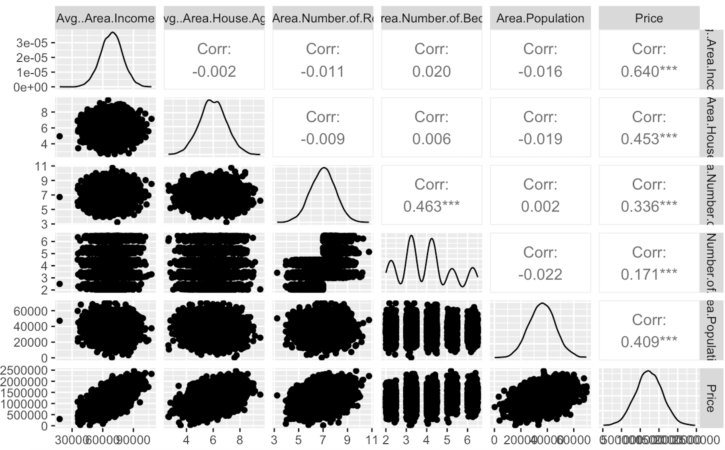
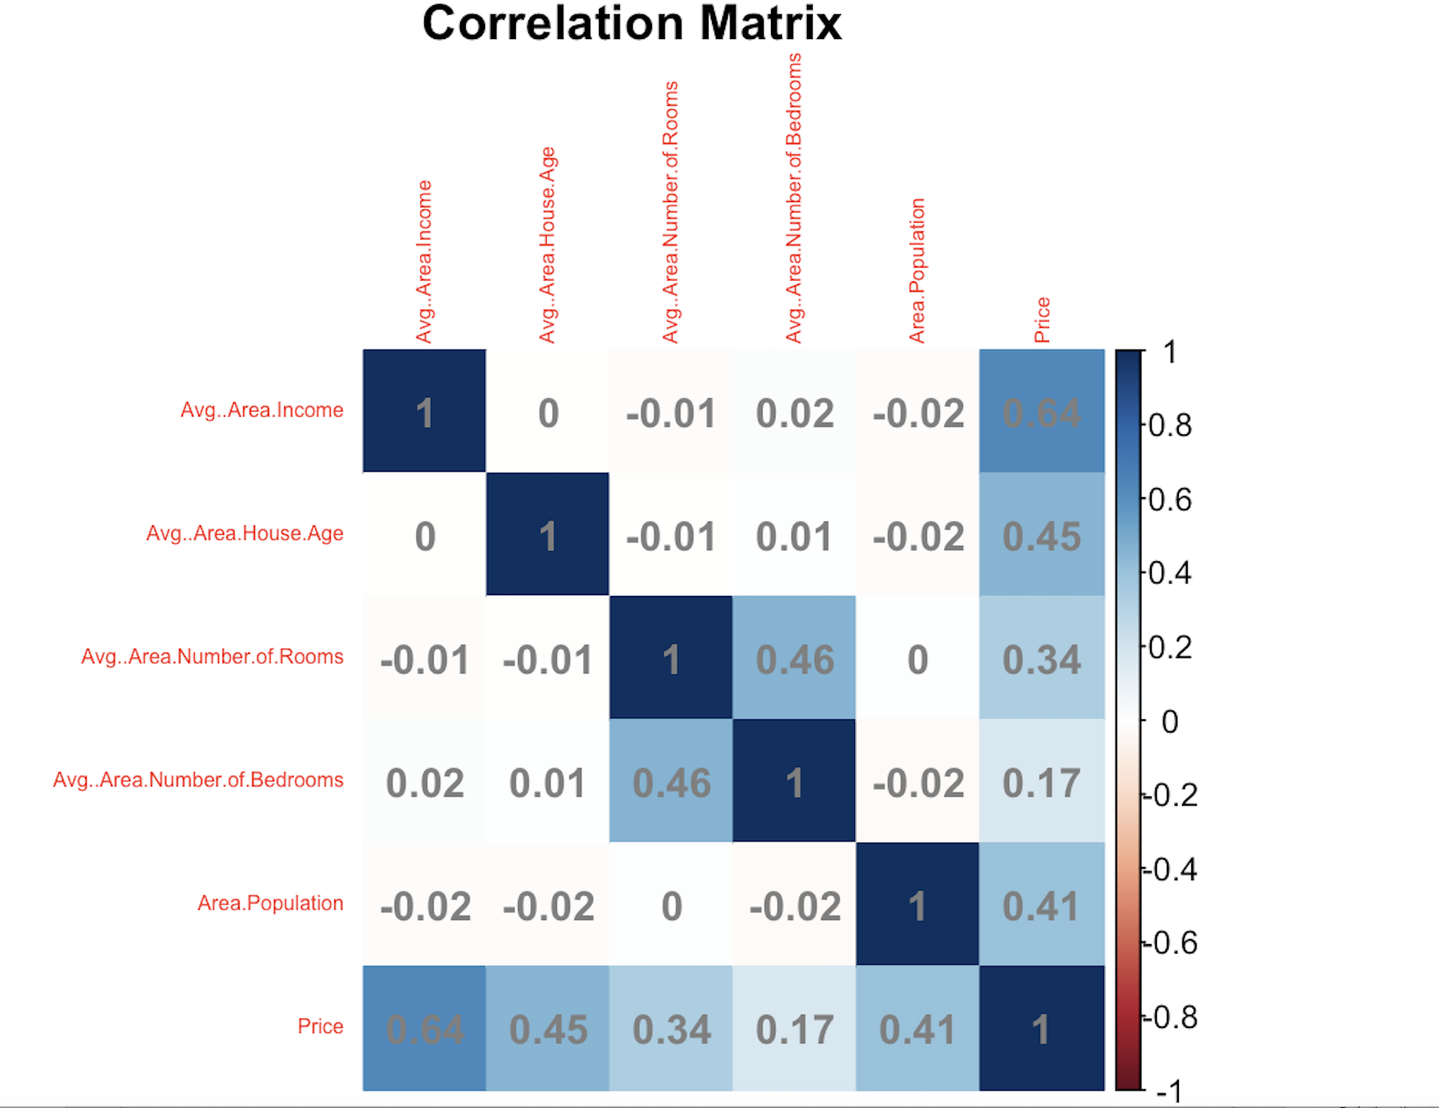

Variable Inspection
From the correlation matrix we can see that the Price of the House is highly correlated with the average area income, average area house age, area population, and average area number of rooms. Therefore, they must be significant predictors for our linear regression model.

Slide 7
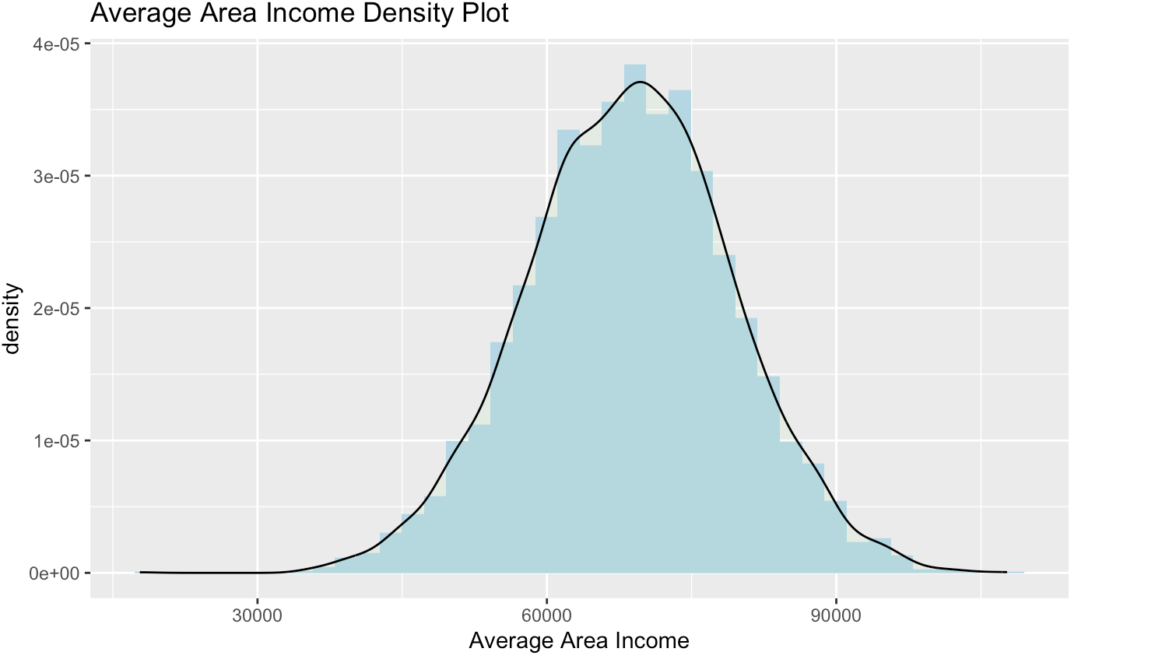
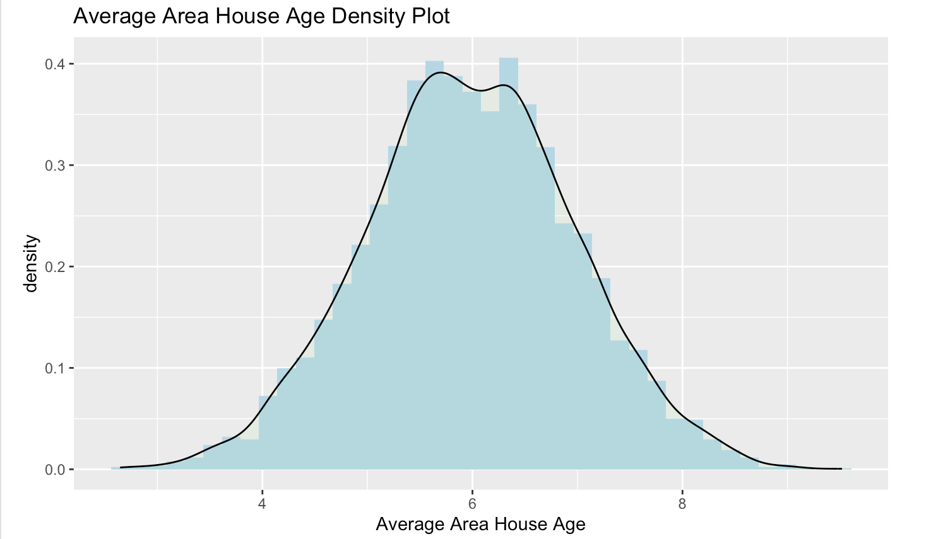
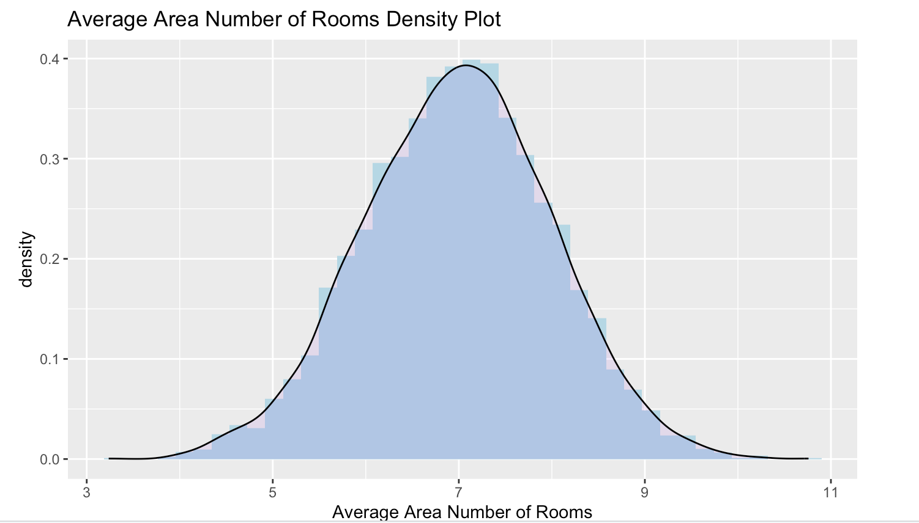
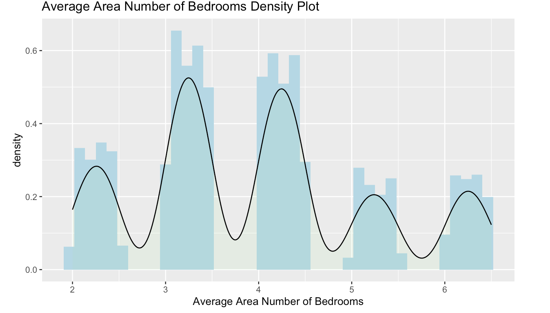
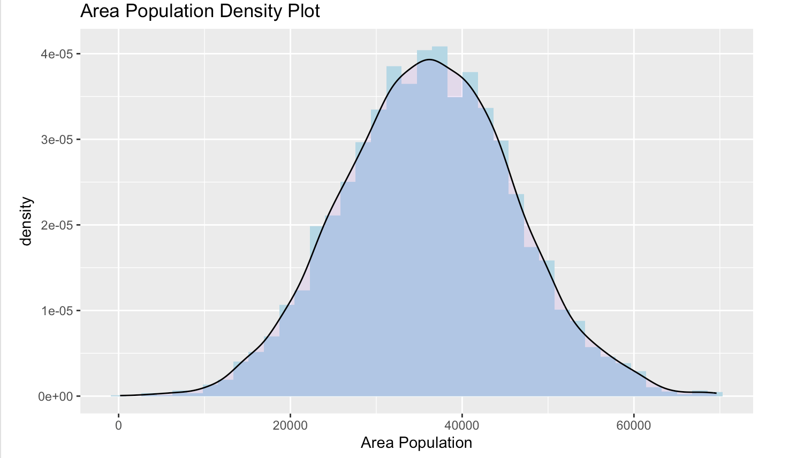
Check for L.I.N.E
L: Linearity
I: Independence
N: Normality
E: Equal Variance

Slide 8
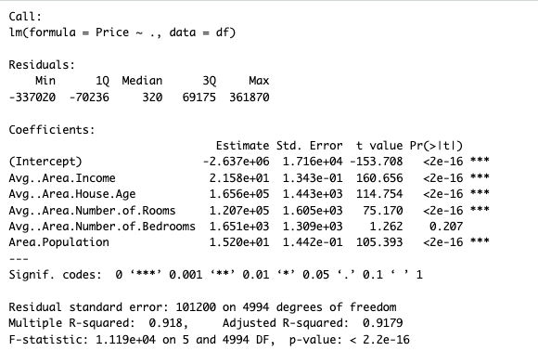
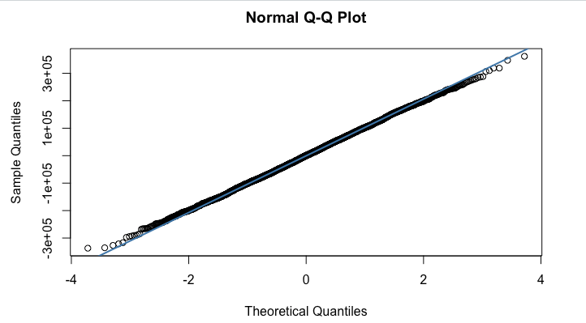
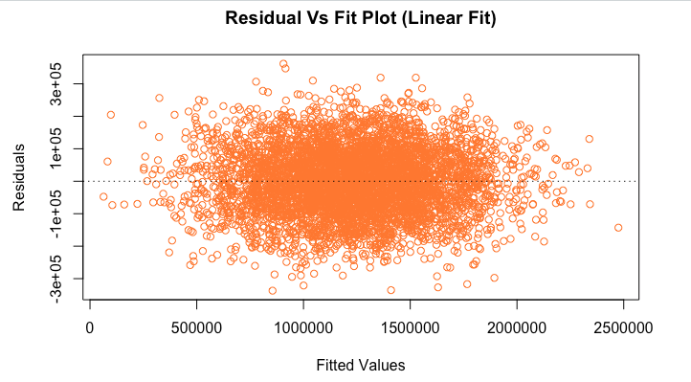
Analysis and Results – Q1** All Predictors
Q1: What combination of features (income, age of houses, number of rooms, number of bedrooms, and area population) are statistically significant in predicting the selling price of a house? (t-test on slope parameters)
$$H_{0}:β_{i}=0 vs.H_{a}:β_{i}≠ 0 where i is all predictors$$
All Predictors Used
Residuals QQ-Plot

Slide 9
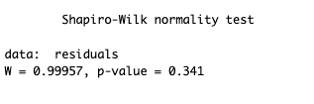
Analysis and Results - Q1
Q1: What combination of features (income, age of houses, number of rooms, and number of bedrooms) are statistically significant in predicting the selling price of a house? (t-test on slope parameters)
Conducting a Shapiro-Test, our null hypothesis is that the vector is Normally Distributed versus our alternative hypothesis where our 1d-array is not normally distributed. Using a significance level of α = 0.05, we can see our p-value is 0.341. Thus, we have p-value > α, therefore we fail to reject our null and conclude that the errors are normally distributed.

Slide 10
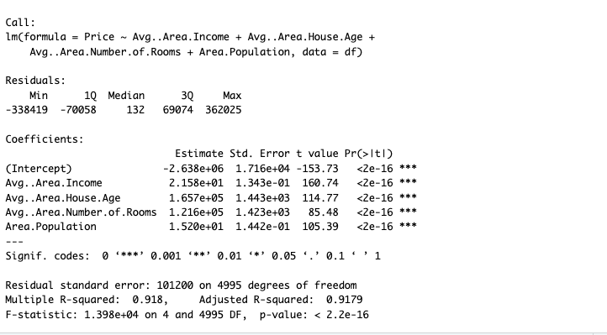
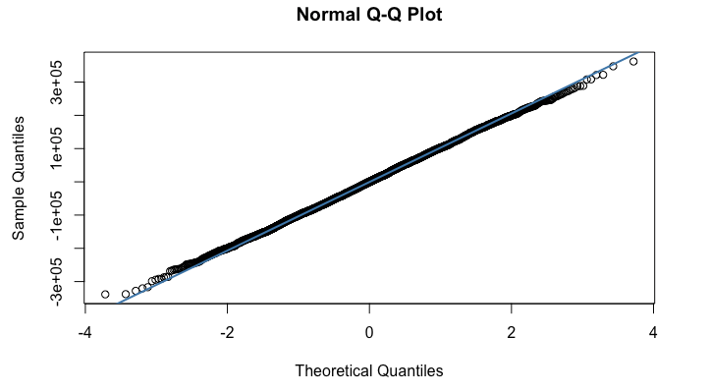
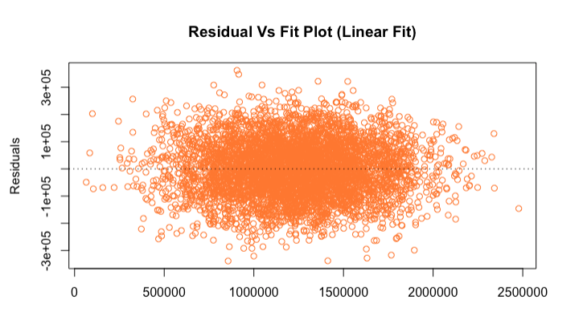
Analysis and Results – Answer**Significant Predictors
Answer: Conducting the t-test on all slope parameters, we concluded that the only insignificant predictor in our model was Average Area Number of Bedrooms, therefore, we can remove it from our model.
Residuals QQ-Plot
Significant Predictors Only

Slide 11
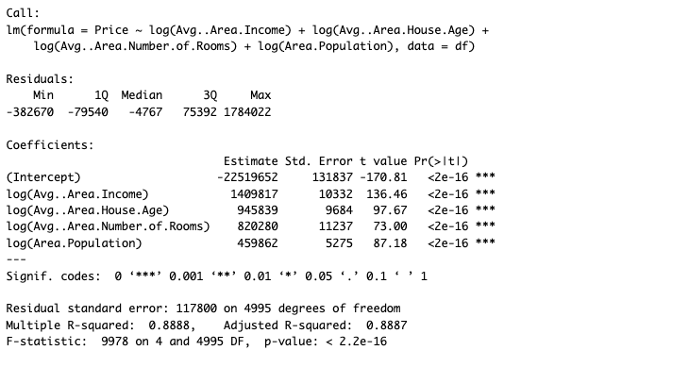
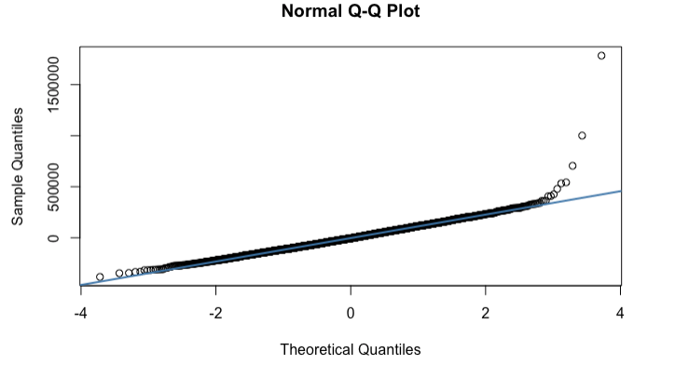
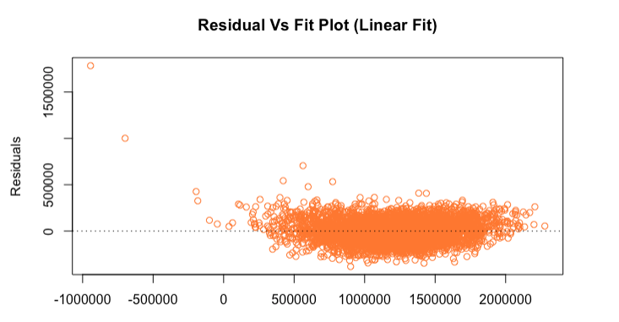
Analysis and Results – Transformation Methods Attempt
Transformations: We transform both our predictors and response variable by taking the Log Function on both and see the effects on the Residual Analsysis
The Transformation failed our normality assumption on the errors.
It also fails to meet the linearity and equal variance assumptions

Slide 12
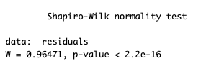
Analysis and Results - Q1
Q1: What combination of features (income, age of houses, number of rooms, and number of bedrooms) are statistically significant in predicting the selling price of a house? (t-test on slope parameters)
From the QQ-Plot above we can see that our residuals lie on the slanted line, hence they seem to be normally distributed. Now conducting a Shapiro-Test, where our null hypothesis is that the vector is Normally Distributed versus our alternative hypothesis where our 1d-array is not normally distributed. Now using a significance level of α = 0.05, we can see our p-value is 2.2e-16. Thus, we have p-value > α, therefore we fail to reject our null and conclude that the errors are normally distributed.

Slide 13
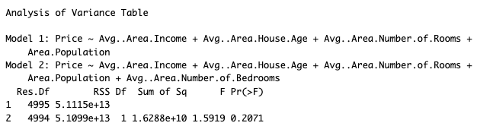
Significant Predictor Check Using General Linear F-Test
Check: Here we check the significance of the predictor Average Area Number of Bedrooms where we concluded from the T-test it was insignificant. Now, we check using the Overall F-test.
$H_{0}:β_{i}=0 vs H_{a}:β_{i}≠$ 0 where i is the average number of bedrooms
Here we check the validity of the predictor average area number of bedrooms using the General Linear F-test. From the T-test we saw that average area number of bedrooms was a statistically insignificant predictor, in the overall F-test we check which model is statistically significant, the model with the predictor average area number of bedrooms or the model without the predictor. The results should be the same as the T-test since the null hypothesis is the same as the t-test. Thus, concluding the reduced model is more significant or in other terms, the average area number of bedrooms is an insignificant predictor.

Slide 14
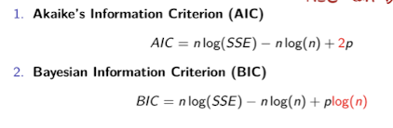
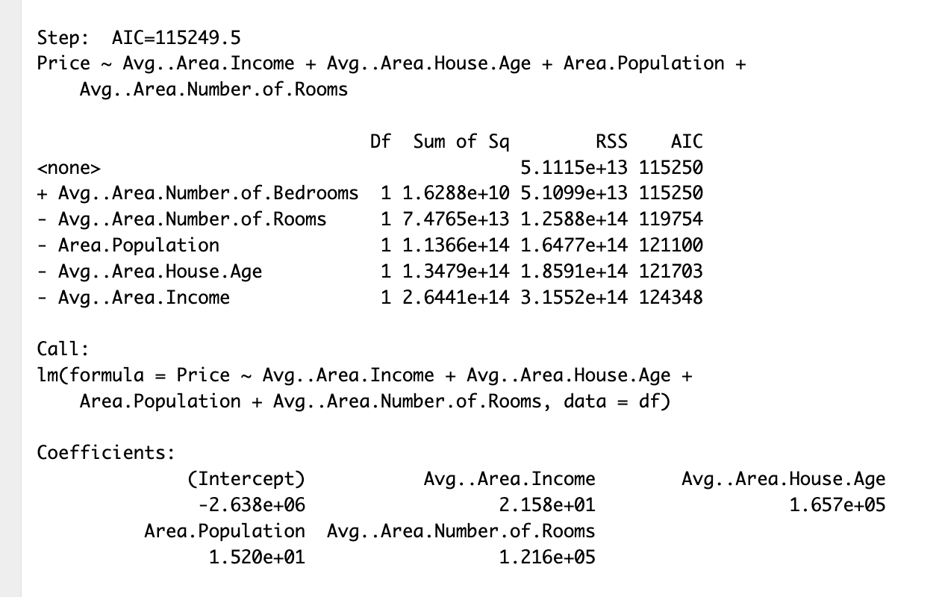
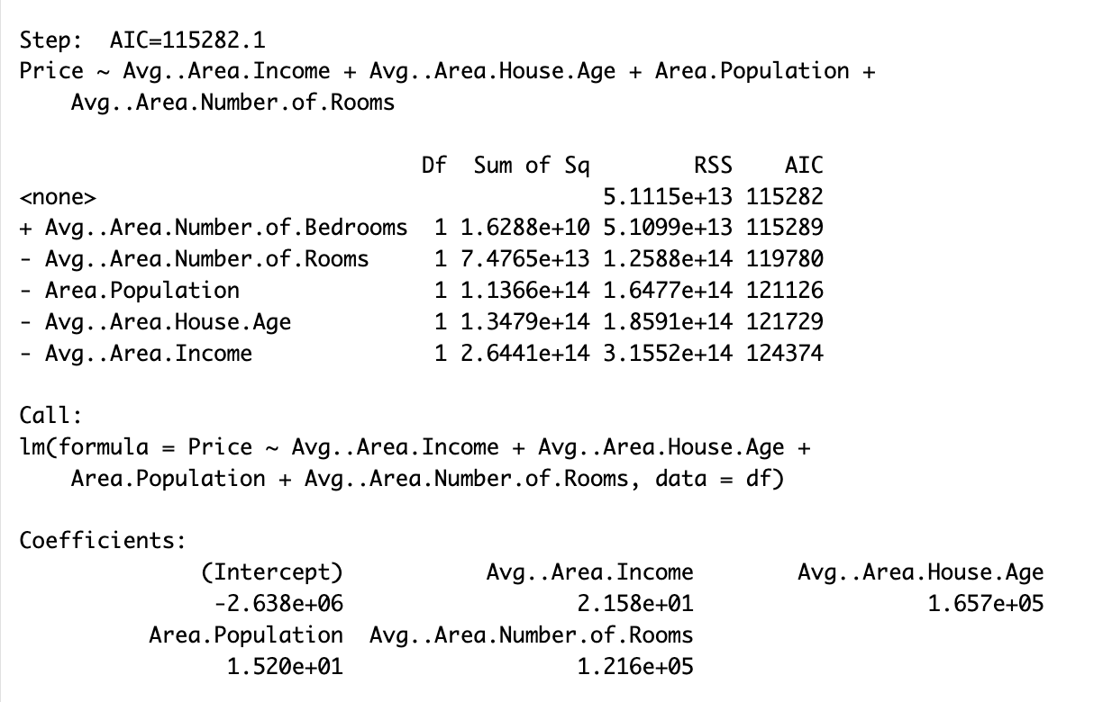
Step-Wise Regression Using AIC & BIC

Slide 15
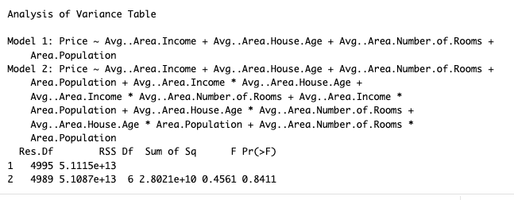
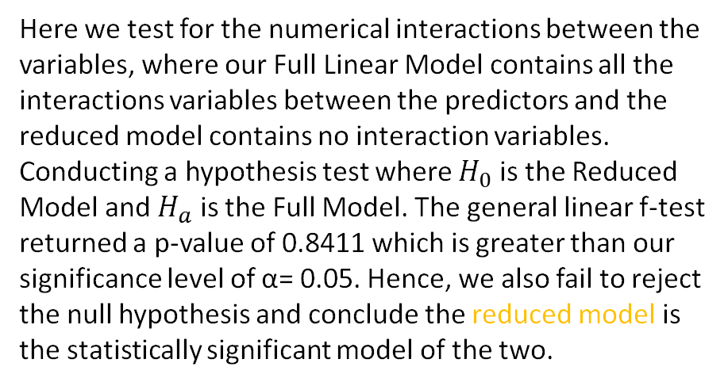
Analysis and Results - Q2
Q2: Is the reduced or full linear regression model best suited to predict housing prices? (General Linear F-Test to check for interactions significance).
Here we test for the numerical interactions between the variables, where our Full Linear Model contains all the interactions variables between the predictors and the reduced model contains no interaction variables. Conducting a hypothesis test where $H_{0}$ is the Reduced Model and $H_{a}$ is the Full Model. The general linear f-test returned a p-value of 0.8411 which is greater than our significance level of α= 0.05. Hence, we also fail to reject the null hypothesis and conclude the reduced model is the statistically significant model of the two.
reduced
Full

Slide 16
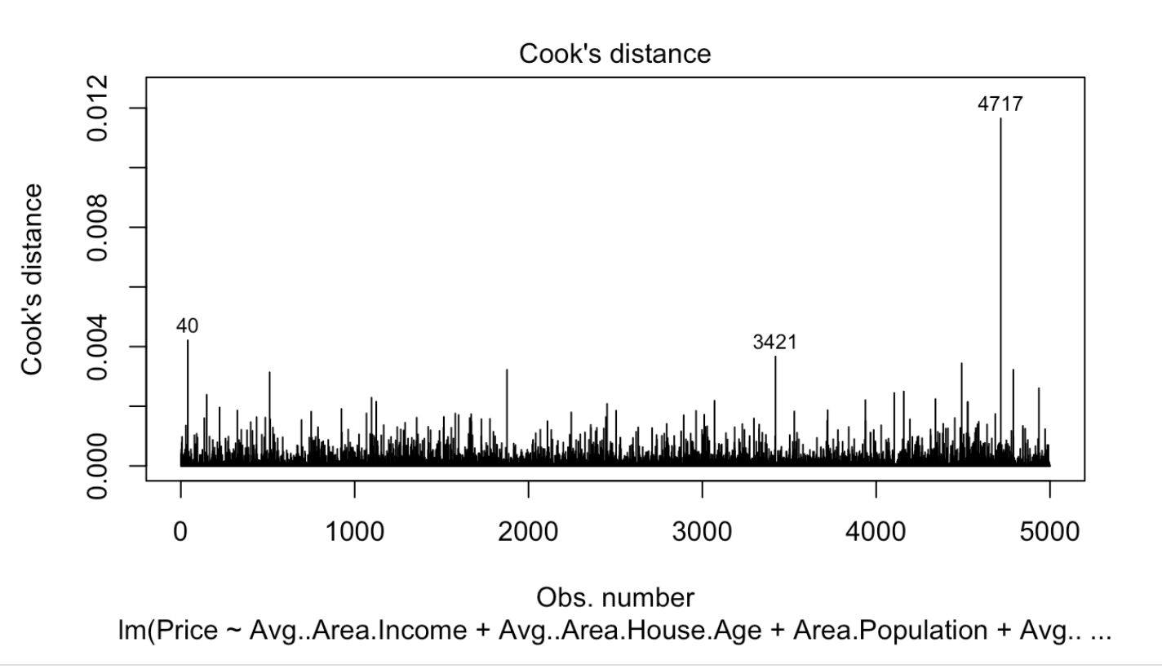
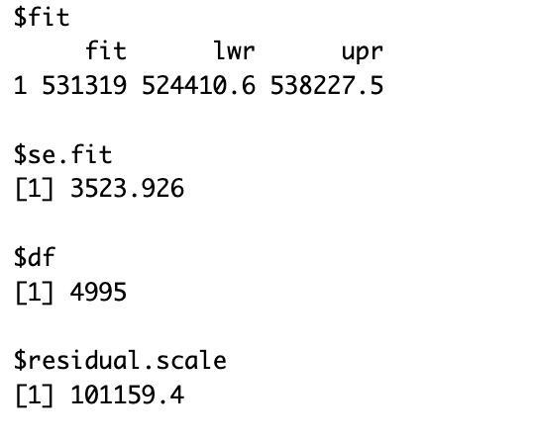
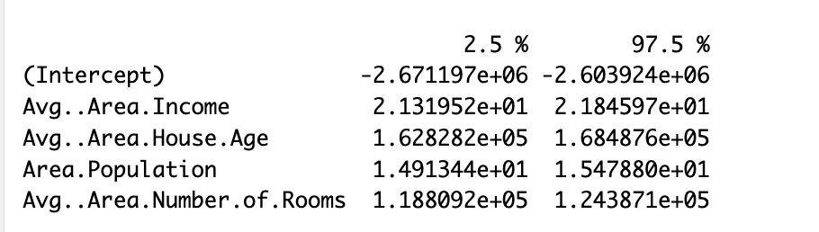
Analysis and Results - Q3
What is the average house price in the United States where the average area income is $50,000, average area house age is 5, an area population of 35,000 people, and average area number of rooms is 6?

Slide 17
Conclusion and further research
House Price: $531,319
We can say that the average house price in the united states where:
the average area income is $50,000
average area population is 35,000 people
average area house age is 5 years
average area number of rooms is 6
We are 95% confident that the observation given above that the house price will lie between $524,410 - $538,227. These numbers seem reasonable and recall the observation in the data set are random across the United States.
How does this price compare to your area or in California?
California is one of the most expensive places to live where the housing prices have increased significantly in the last 3 years due to the pandemic and inflation(Bank Loans).
*** Warning we also do not have the years when these observations were taken place and has a huge factor since the last 3 years, we saw a huge increase in housing prices. Moreover, we did not group the addresses so it would have an impact on our predictors.

Slide 18


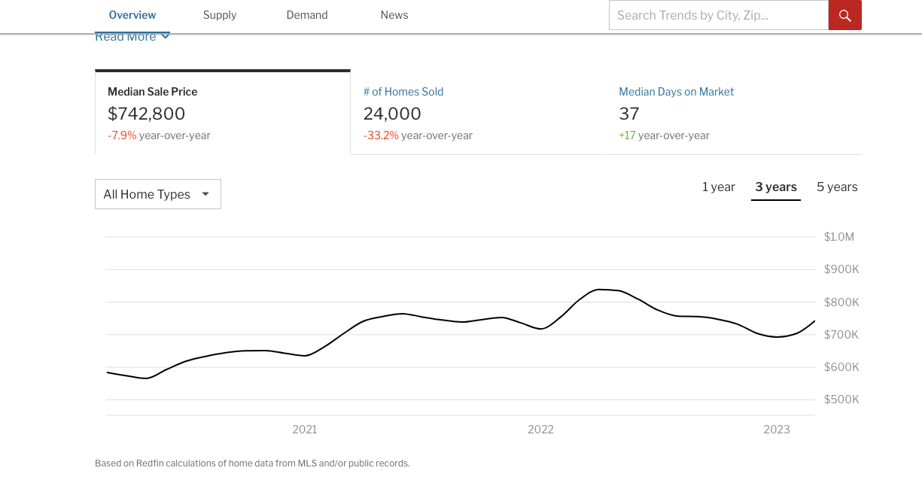
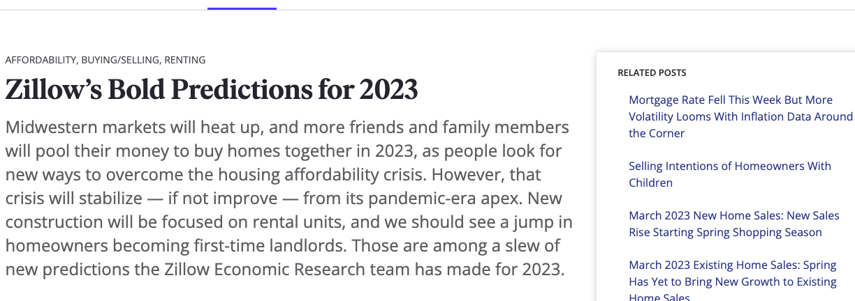
Thank You STAT 510 & Dr. Liao

